Slide 1
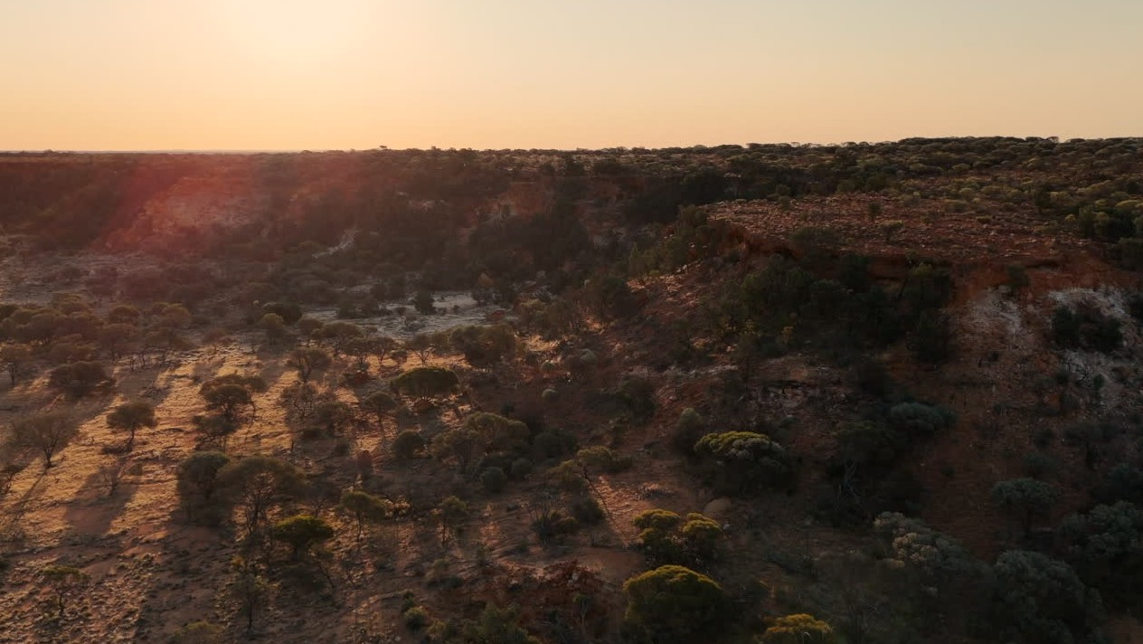

Slide 2
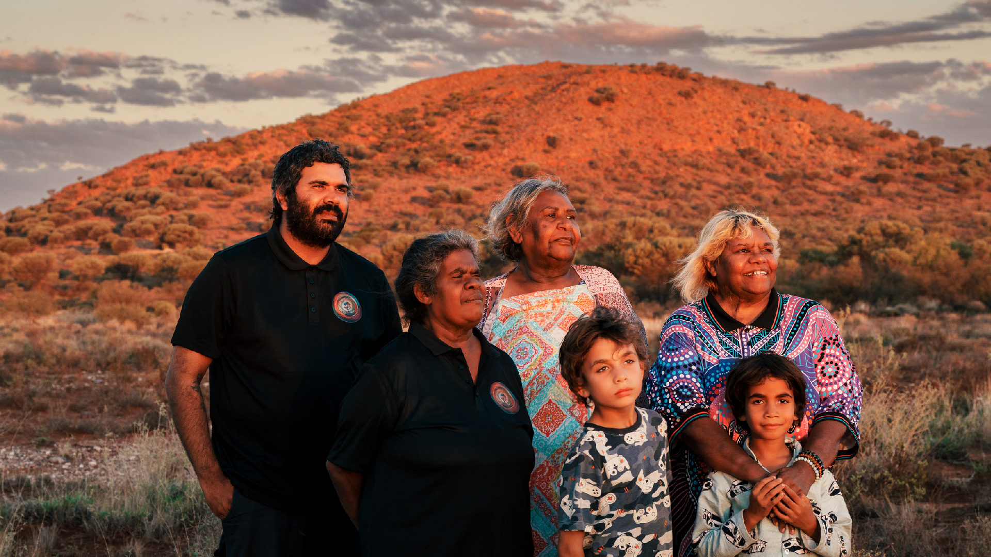


NYUNNGAKU
Cultural Launch Presentation
Nyunngaku Aboriginal Corporation
www.nyunngaku.com.au

Slide 3


Cultural Launch Presentation
TABLE OF CONTENTS
This table of contents maps our journey—who we are, what we’ve achieved, and where we’re heading.
Introduction
Timeline
2026 Highlights
Governance
Our Leaders
Our Model
Community Support
Education
It highlights our 2026 milestones, leadership, governance, and the community-led programs driving real impact. From education and support to future pathways, each section reflects our commitment to culture, community, and long-term opportunity.
Nursery
Next Chapter
This is not just a presentation — it’s our story of growth, strength, and the road ahead.
www.nyunngaku.com.au

Slide 4
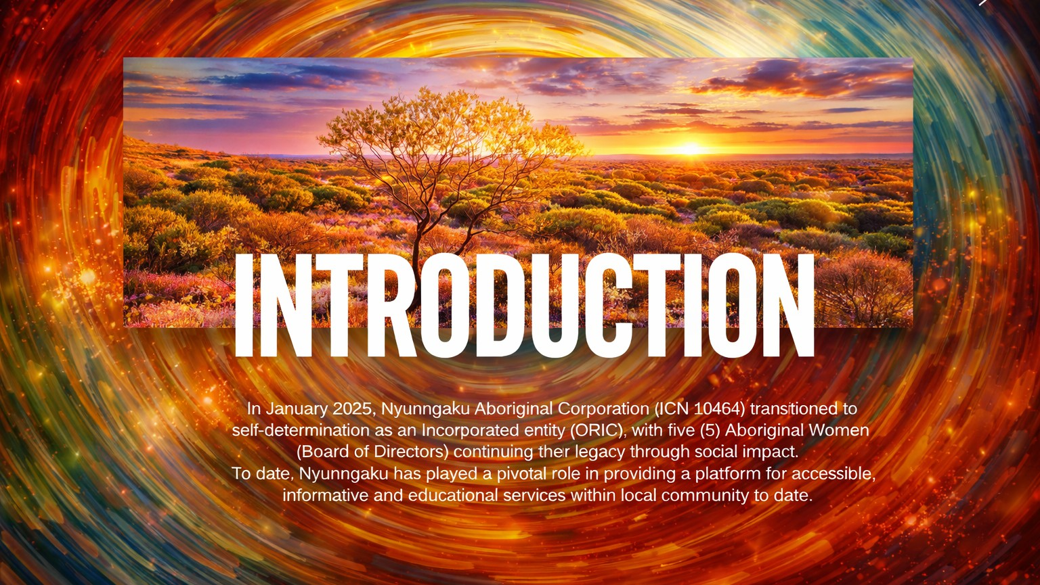

Slide 5
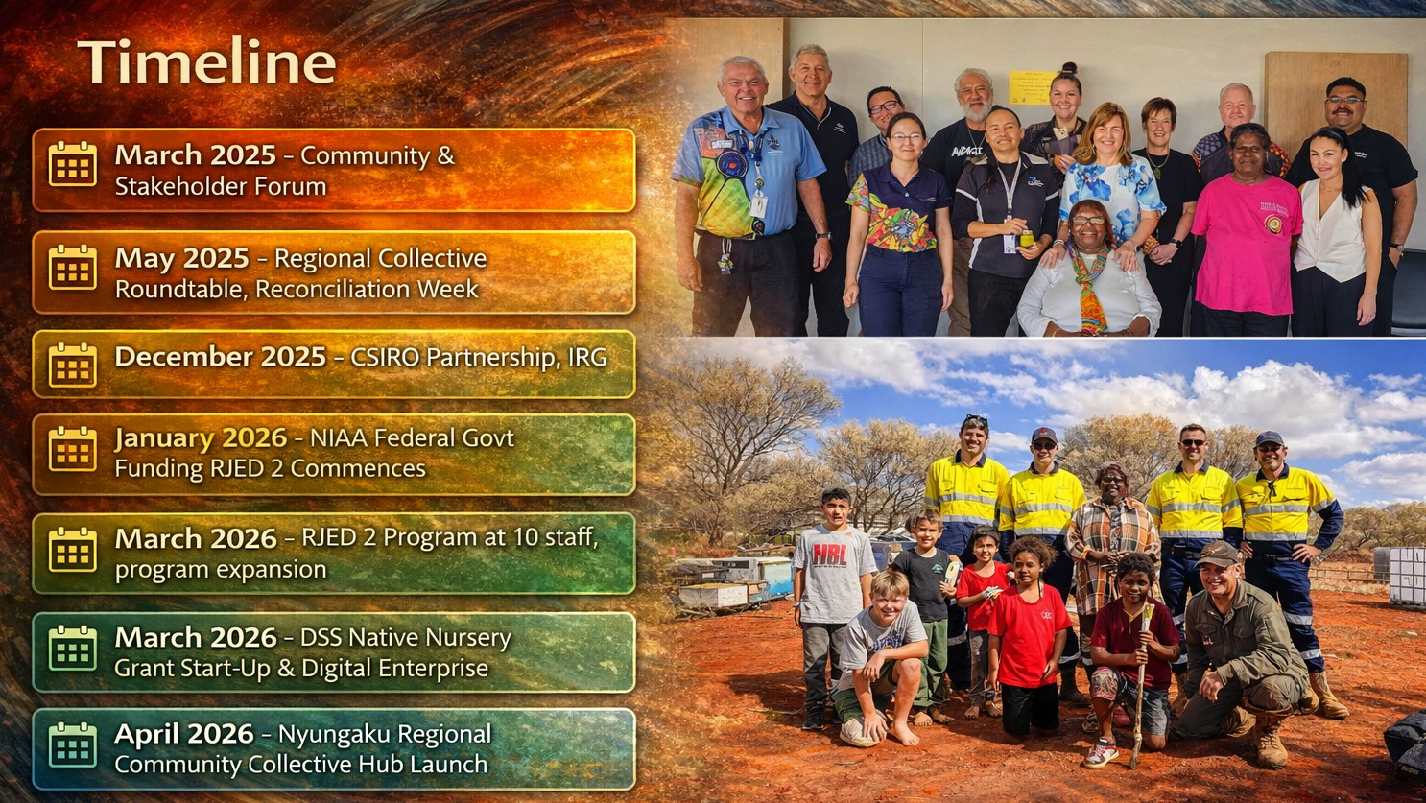

Slide 6
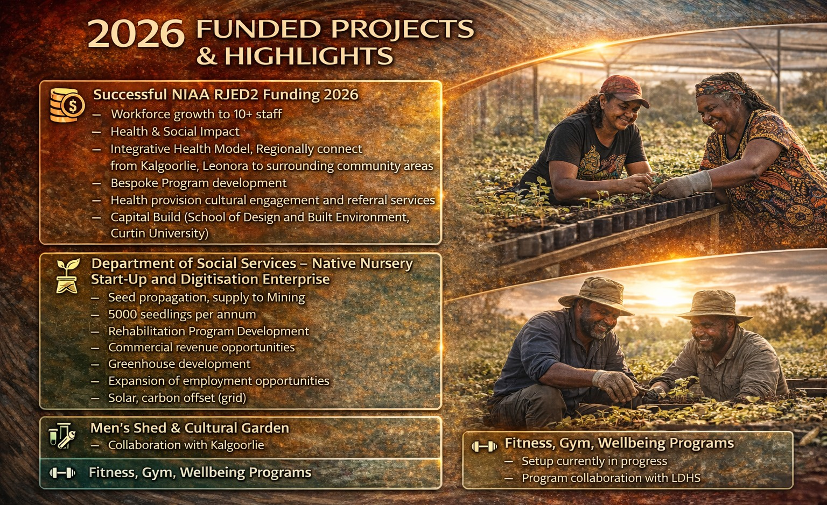

Slide 7
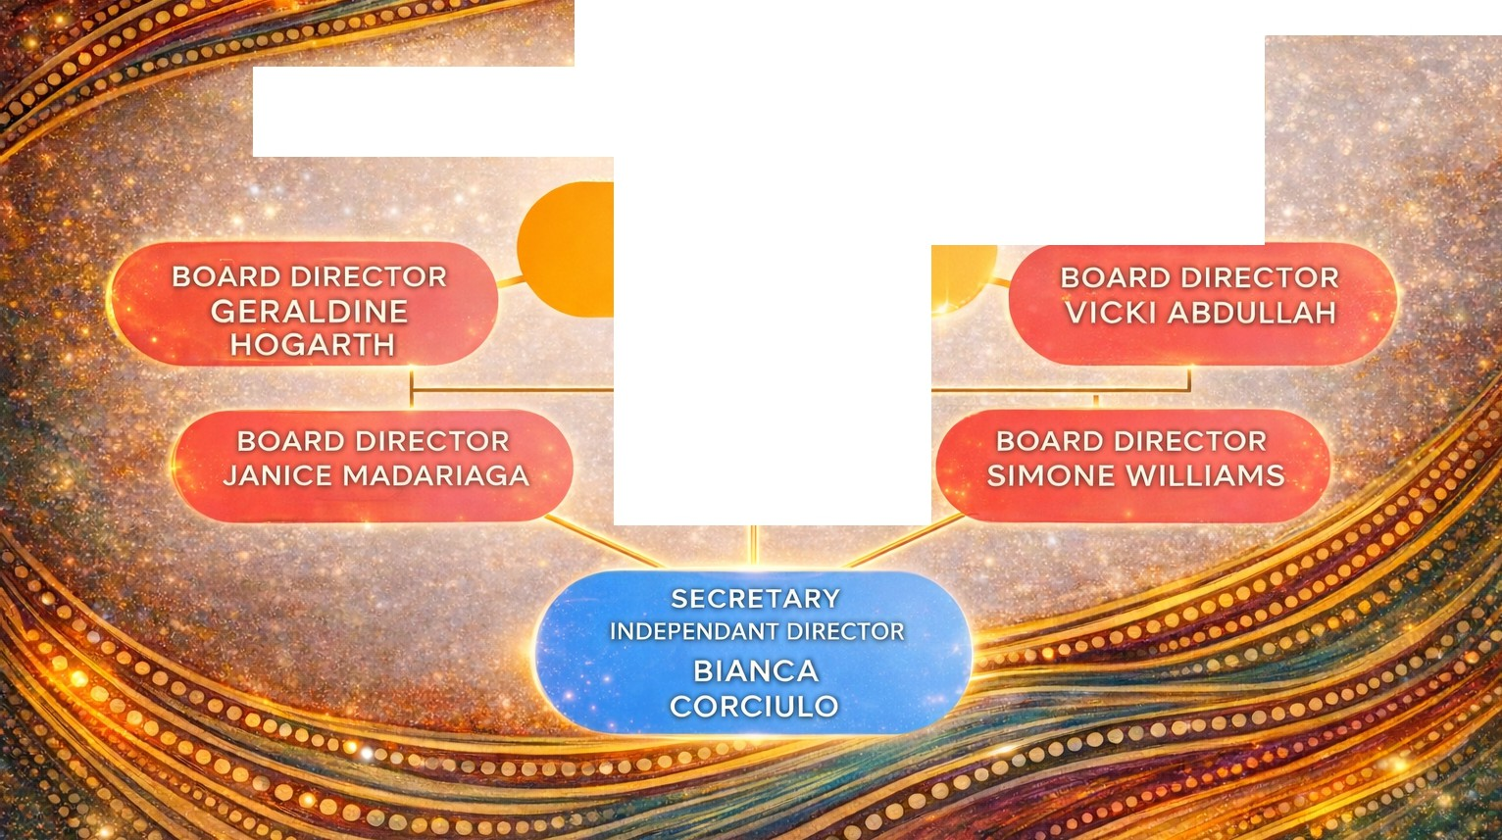
NYUNNGAKU ABORIGINAL CORPORATION
DIRECTOR/FOUNDER
COLLEEN BERRY
CFO

Slide 8
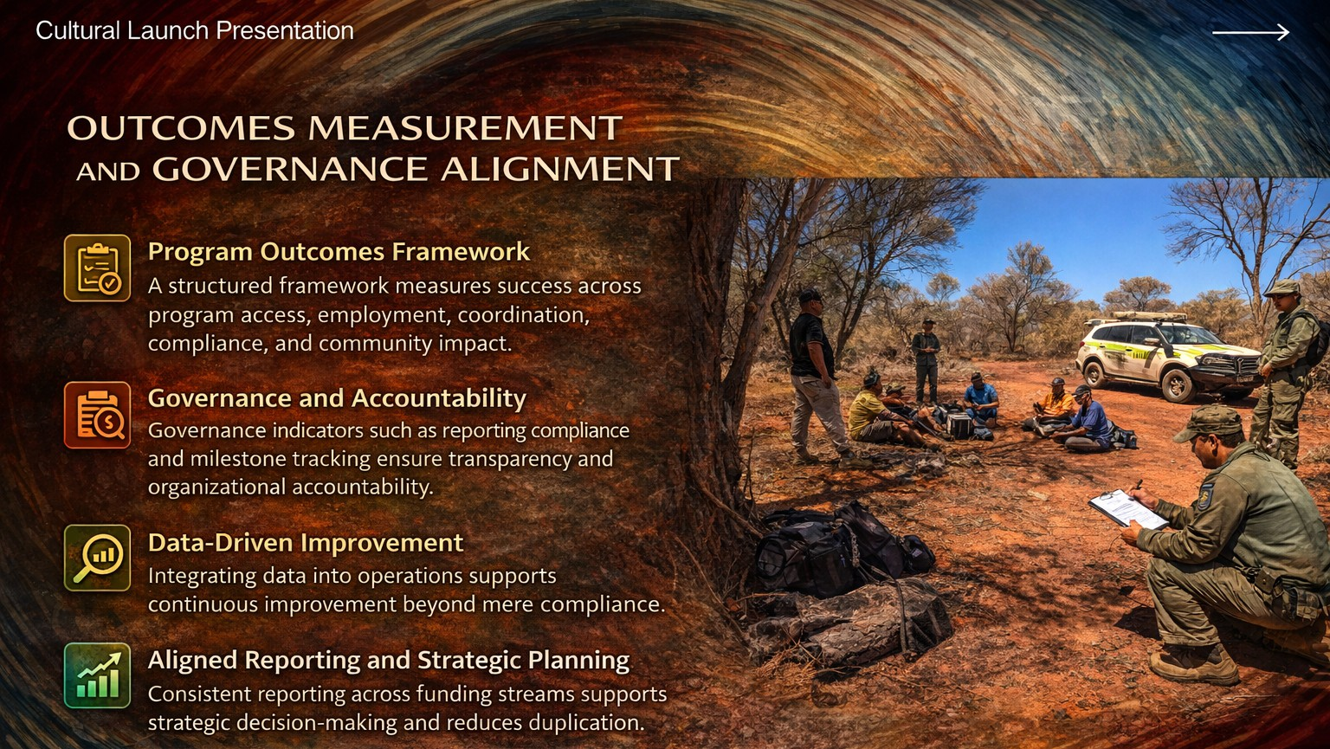

Slide 9
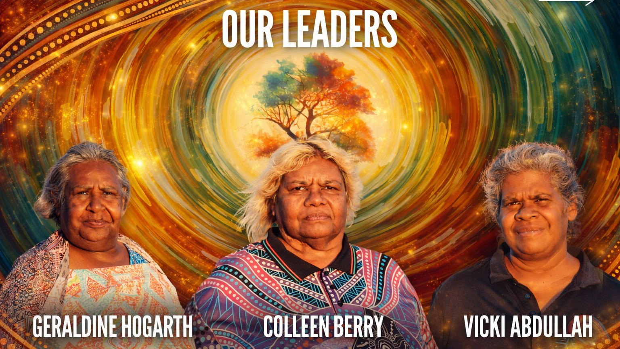
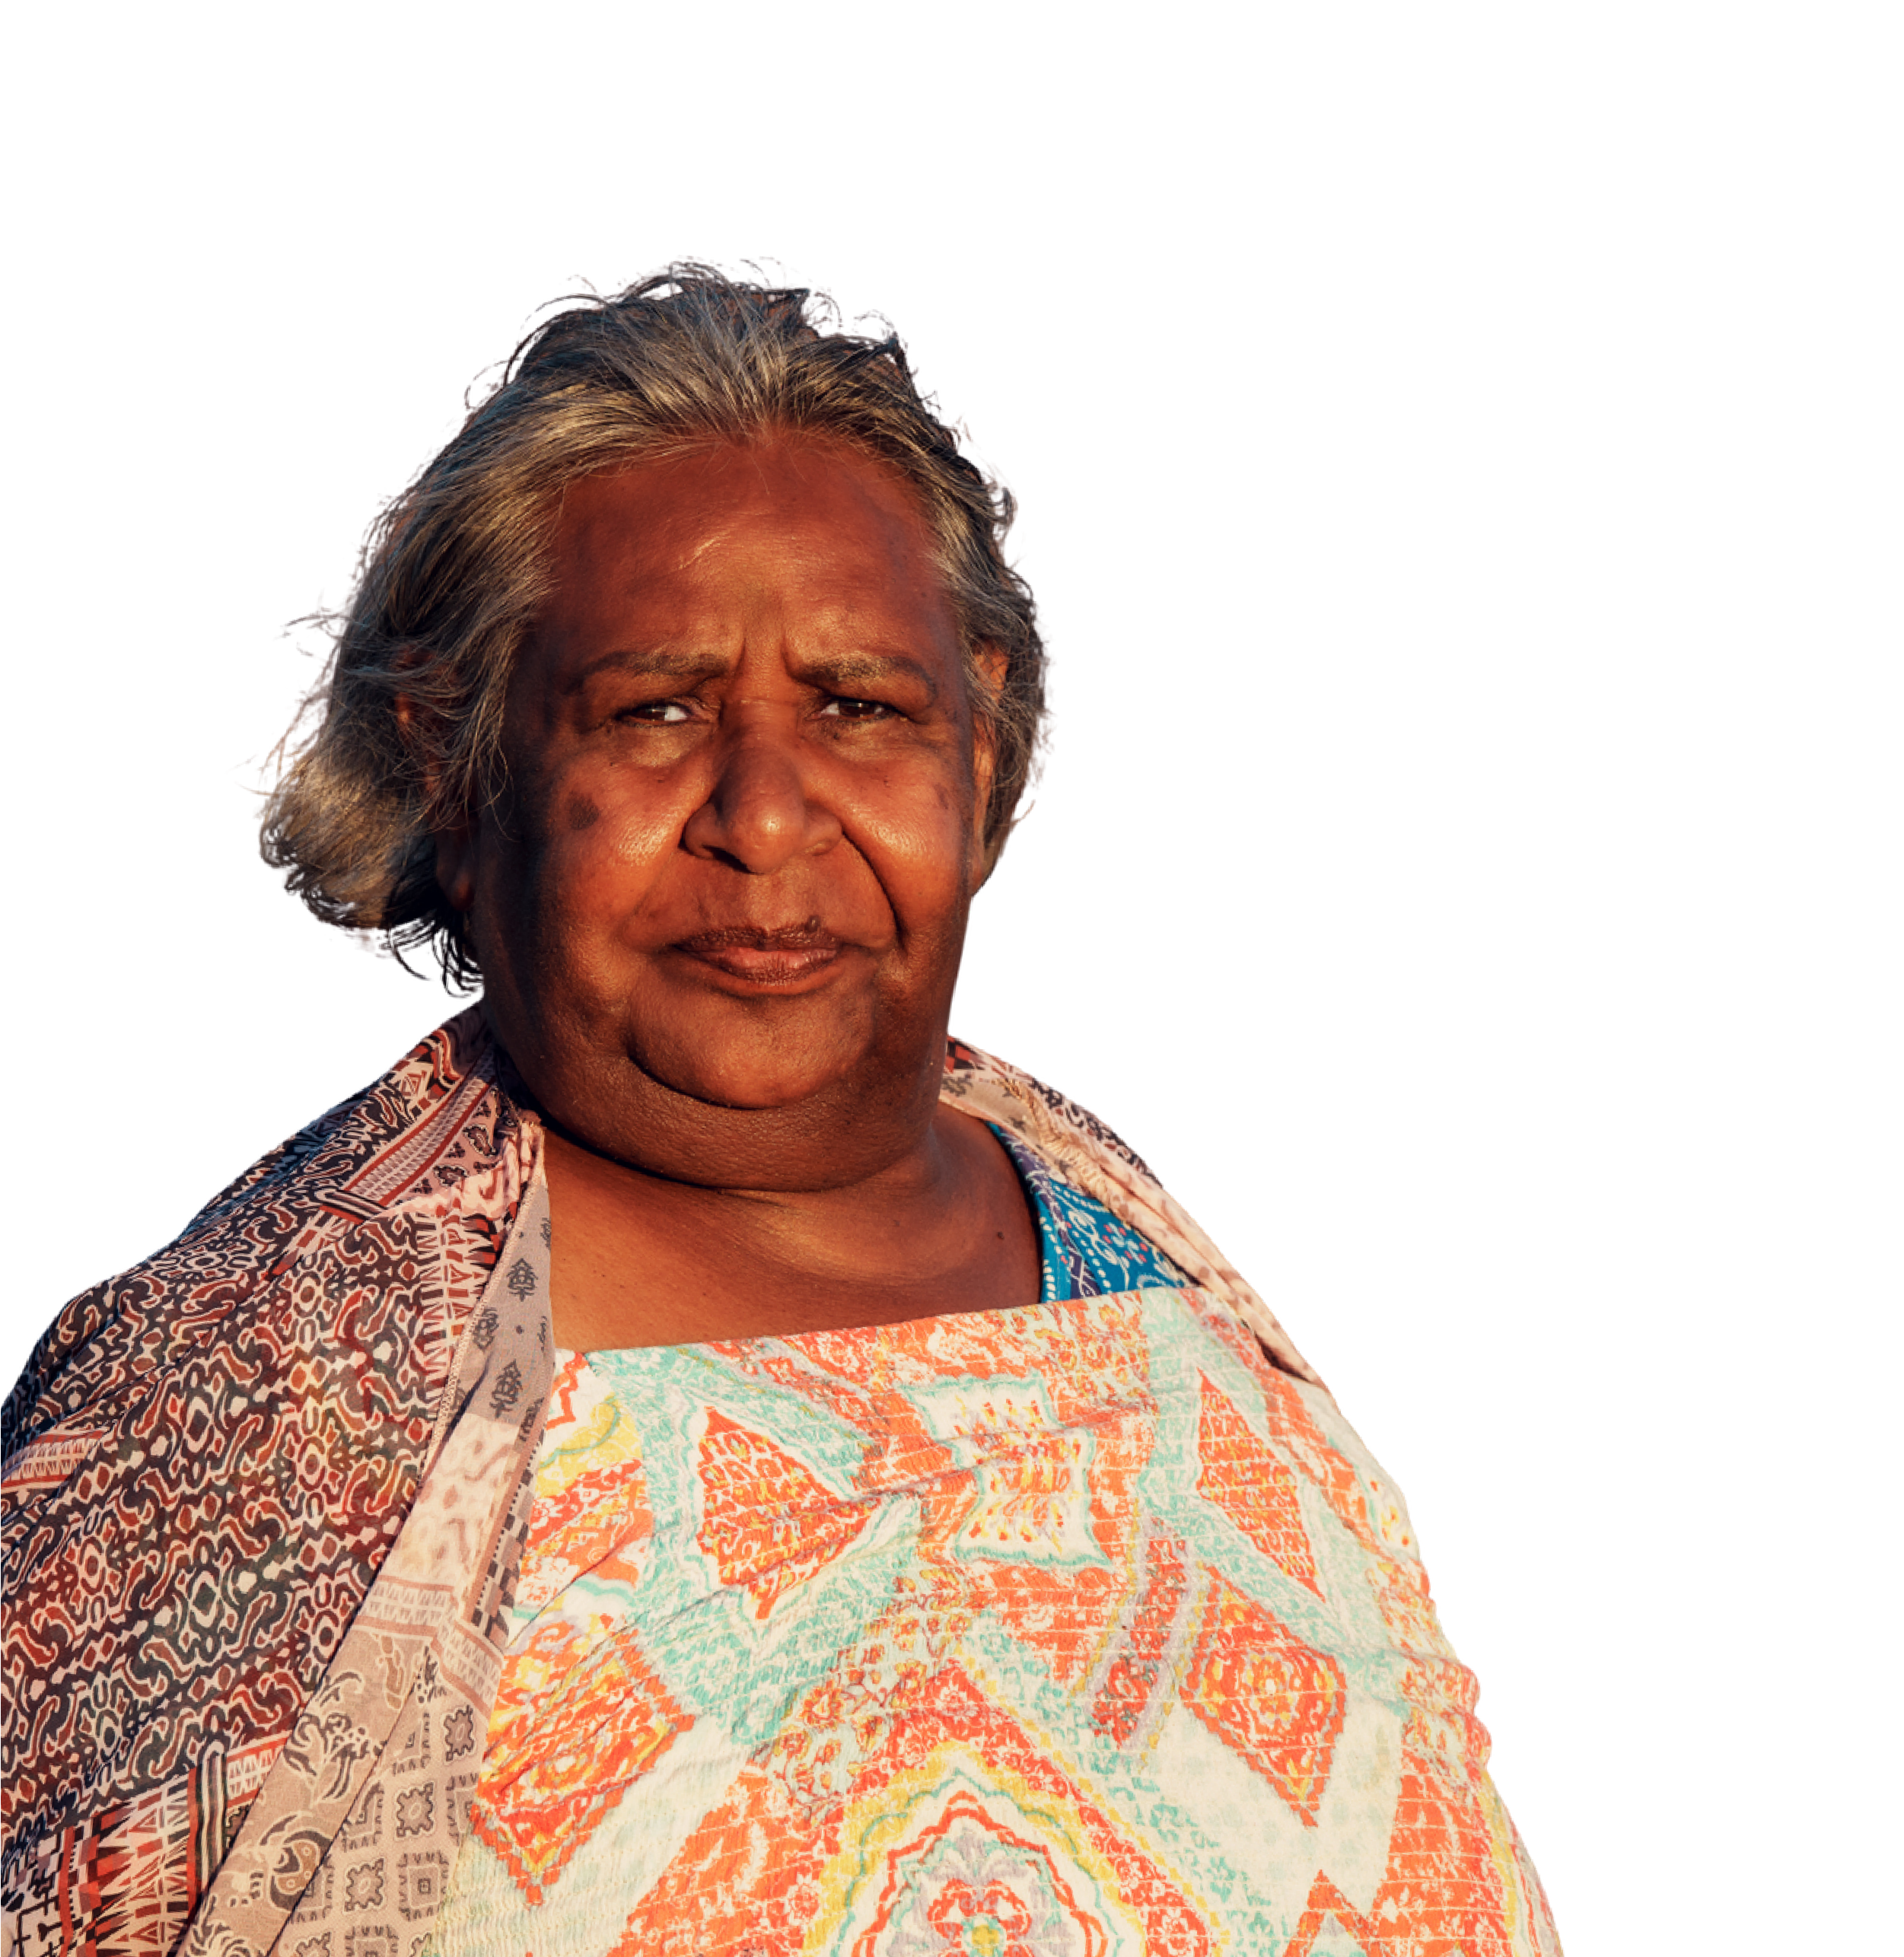
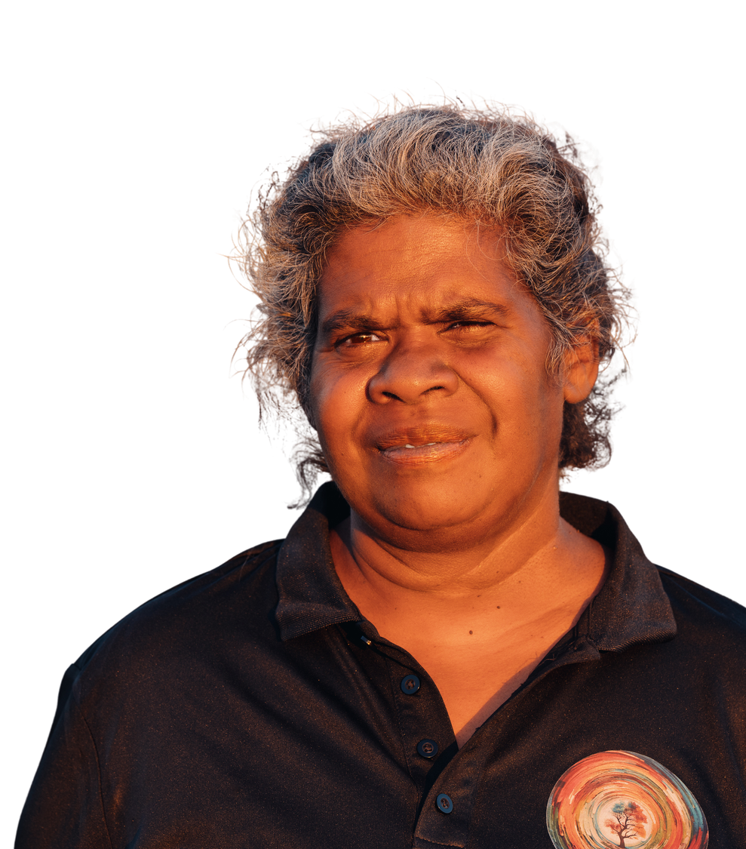
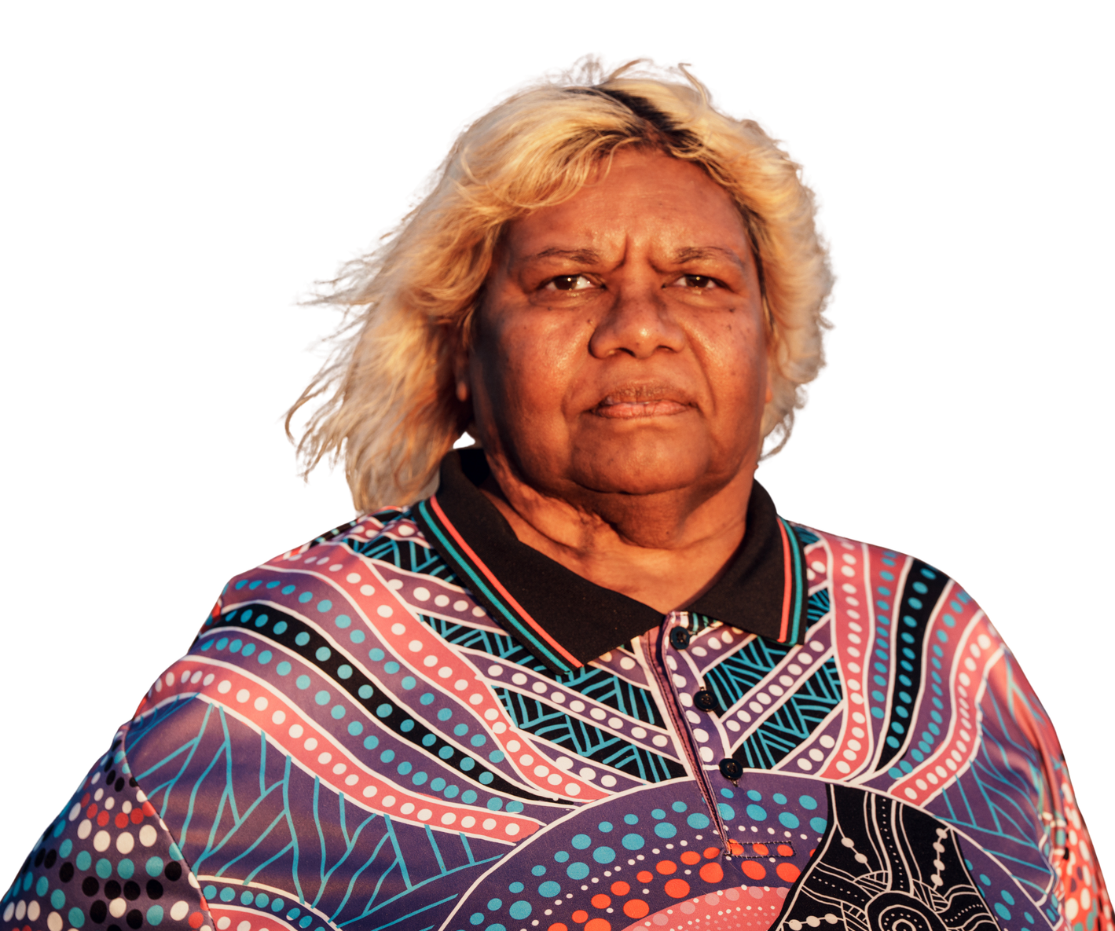
OUR LEADERS
GERALDINE HOGARTH
COLLEEN BERRY
VICKI ABDULLAH

Slide 10
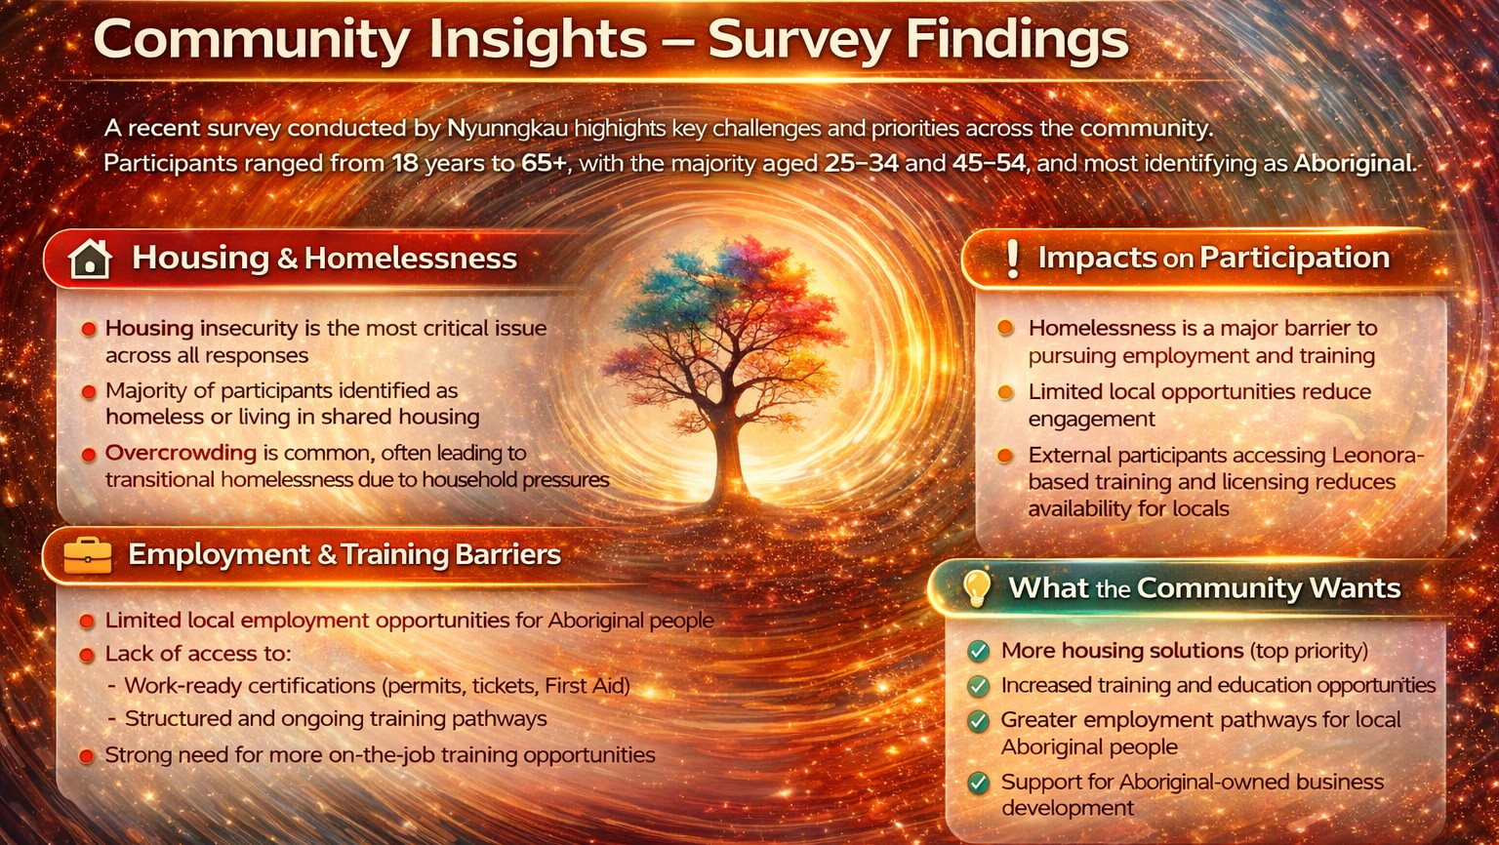

Slide 11
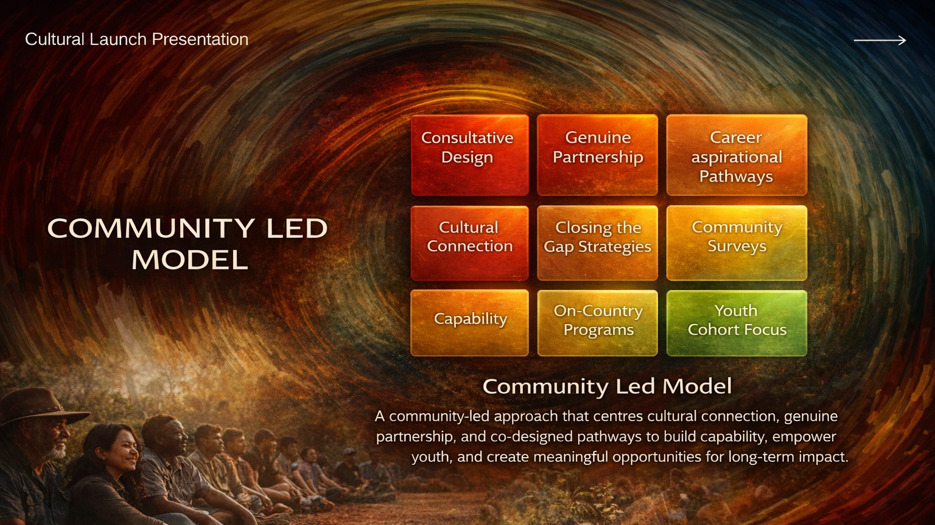

Slide 12
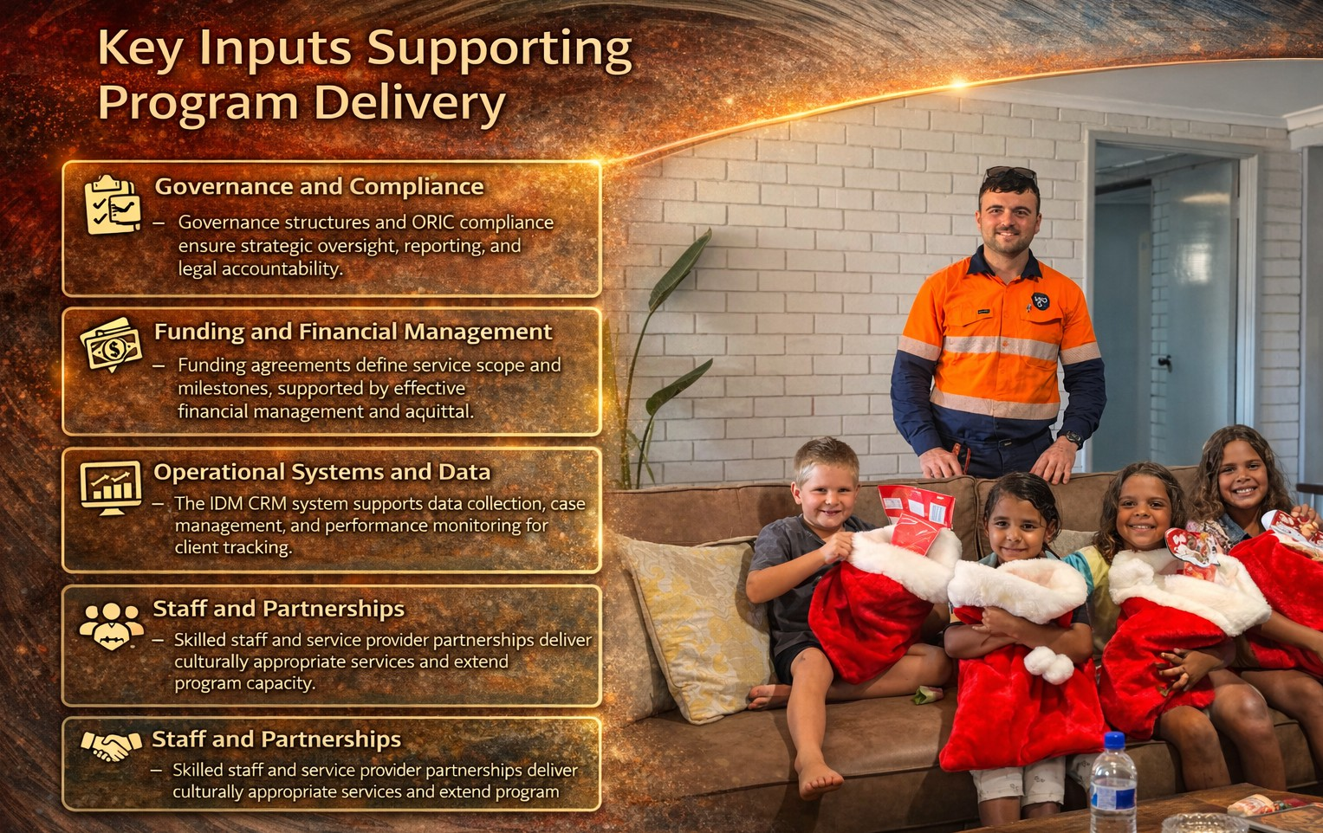

Slide 13

Aboriginal Family Safety Strategy
Dept of Communities 2026
Nyunnga Ku Aboriginal Corporation
&
Aboriginal Economic Reform Collated Learnings Goldfields/Esperance

Slide 14
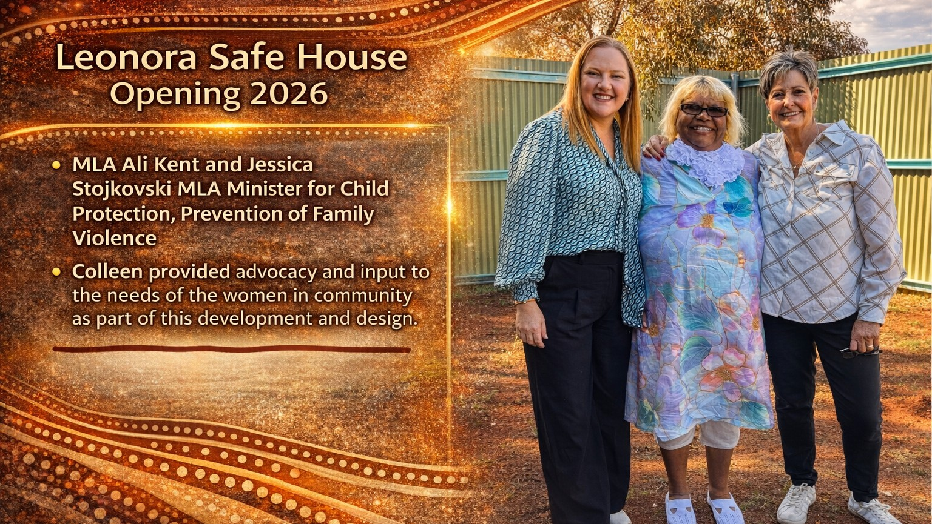


Slide 15
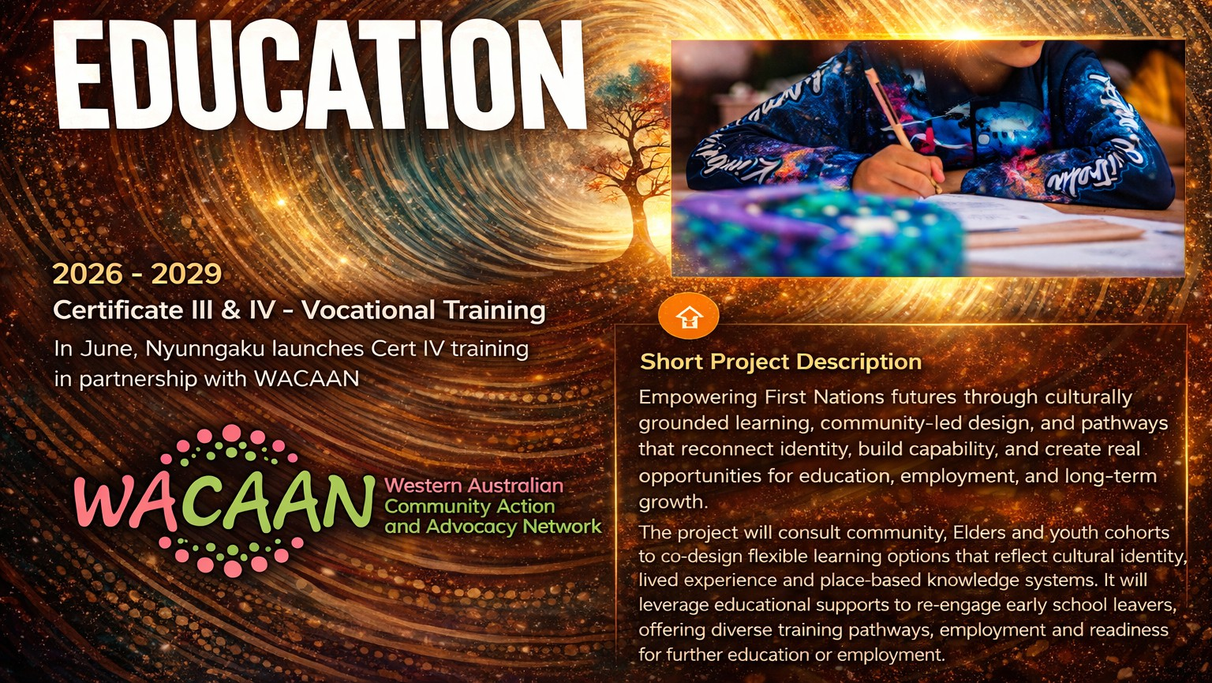

Slide 16

Education - Community
Go11aboration, Capabi1ity Building
Leonora District High School
Community Seedling Project
Community Mural Project Year 12 Placement
Youth Career Pathways Development
Supported training models to prevent disengagement
Curtin UDRH Intern Opportunities

Slide 17

Native Nursery Project
"This project is about more than plants - it's about restoring connection to Country, strengthening cultural knowledge, and creating sustainable pathways for our community,
The Native Nursery Project is a community-led initiative that brings together cultural knowledge and environmental stewardship to grow locally significant plant species.
..., Hands-on training & employment pathways
Culturally grounded practices to support biodiversity & identity
Build land management, conservation & economic skills
We are growing not just plants - but people, culture, and future opportunity.

Slide 18
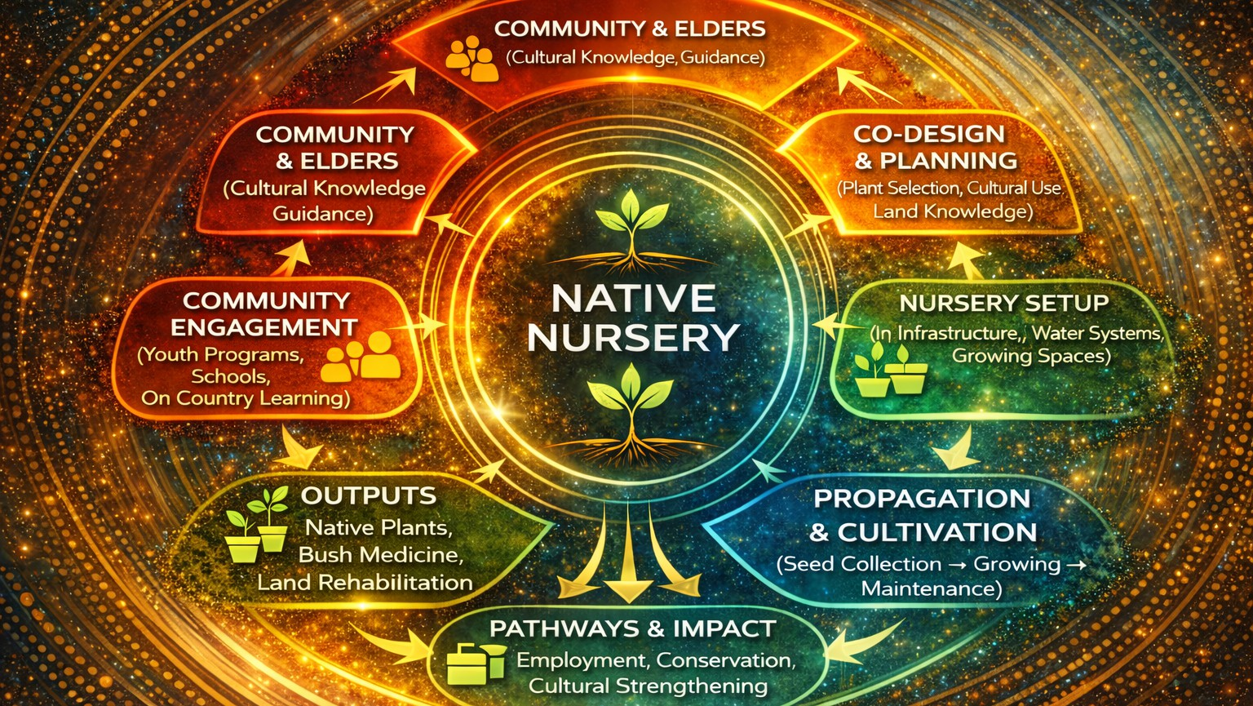

Slide 19


Slide 20

Expanded programs
  Native Nursery, Supply Native Flora - Mining Partnership opportunities
  Carbon Offset, Solar Energy - Indigenous Energy Australia
  LLND Programs designed with community (Language, Literacy, Numeracy, Digital)
  Our Way Forward - Aboriginal Family Safety Strategy
  REAL Justice Transitional Program Focus (DEWR)
•
,I "

Slide 21

THANK YOU
Nyunngaku Aboriginal Corporation
www.nyunngaku.com.au

